Slide 1

Quantum Communications Group
KML Minimal Implementation Proposal
Weekly Report
Supervisors:
Armando Nolasco Pinto
anp@ua.pt
Diogo Matos
dftm@ua.pt

Slide 2
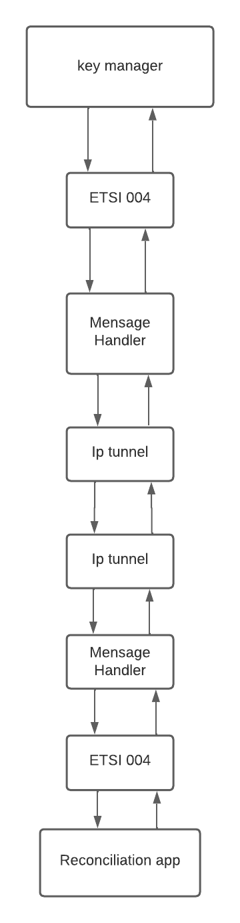
Diagram South interface
In order for the KMS to provide keys to the applications, it first needs to receive key material from the physical layer (a set of QKD devices).
The interface between those two is based on ETSI QKD 004 in push mode (the KMS is always receiving keys without making individual requests for each one). This interface is basically the same as the one provided by the KMS for the applications to use but now the KMS will act like an application requesting key material.
The QoS parameters are the ones defined by ETSI since usually each QKD device can only provide one key type. The KMS will start by making an OPEN_CONNECT request to create a connection to the QKD device. Then does one GET_KEY request and from that moment forward it will receive key material with the characteristics and pace specified in the QoS field until it makes a CLOSE request to terminate the key stream. The Quantum Key Distribution (QKD) device provide key material to the KMS by continuously sending key_buffers with its respective metadata.

Slide 3
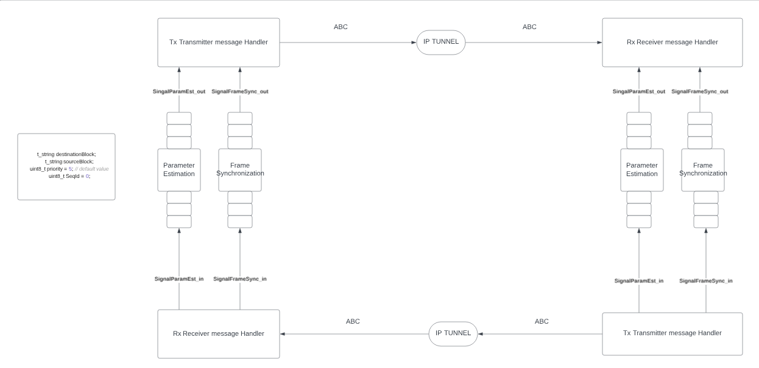
Specification of input and output signals
Notes:
O método básico de retransmissão de chave é feito usando One Time Pad (OTP) executar um XOR entre a chave a ser retransmitida e uma chave que ambos os KMSs pares conhecem
Esse processo de key relay é feito por um conjunto de KMSs (que estão conectados através de KMLinks), e o método de relay é feito usando One Time Pad. (fazendo um XOR entre a chave a ser transportada e a chave que ambos os KMSs conhecem

